Slide 1




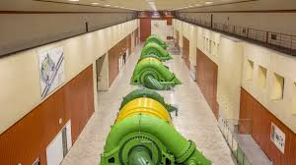

HYDRO+ 2025
Die Wasserkraft von „analog“ zur "KI" 23.05.2025
8:30 – 15:30 Uhr Freie Universität Bozen Sparkassenstraße 21 –Bozen Saal D1.02
Our partner in Italy:
Predict to Perform
Valorisation of historical data through digital twins generated by Machine Learning applied to a 60MW pump-turbines
YJ
Yvan Jacquat
Founder & CEO GradeSens

Slide 2

Topics:
Introduction
Modelling methods
Use case & data Engineering
Conclusions
YJ

Slide 3
Challenges
Climate Change & Hydrological Variability
Changing precipitation patterns, prolonged droughts, and glacier retreat impact water availability.
Extreme weather events (e.g., floods) can damage infrastructure and disrupt operations.
Aging Infrastructure & Investment Needs
Many European hydro plants are decades old and require upgrades or repowering to remain efficient.
High refurbishment costs and long payback periods make modernization financially challenging.
Competition & Market Integration
Increased integration of intermittent renewables (solar & wind) affects electricity pricing.
Cross-border grid constraints and market fluctuations impact hydro's role in balancing the grid.
Grid Stability, Blackout Risks & Need for Reliable Power
As Europe transitions to more variable renewable energy sources (solar & wind), the risk of grid instability and blackouts increases.
Hydropower, especially pumped storage, is crucial for balancing supply and demand.

Slide 4
Objectives
WHY
Strategy
Knowledge-based asset management
Improving grid balancing
Fostering innovation & excellence
O&M
Faster ramp-up and ramp-down
Maintenance schedule optimisation
O&M cost reduction
HR
Empowering a data-driven culture
Enhancing decision-making, efficiency, and problem-solving
HOW
Value of data
Proactive failure detection
Identifying power inefficiencies
Gaining knowledge on the machine behaviour
Digital architecture
Scalable and robust architecture
Transparent modelling (not a black box)
Cybersecurity
Compliance with Swiss regulation for critical assets
WHAT
Data
Leveraging of existing SCADA data
AI-Analytics
Dedicated Models covering the generator and turbine
Algorithms optimized for limited data
Knowledge
Transparent metrics updated on a daily basis
Monitoring and preventive actions

Slide 5
Questions from KWO?
?
What is the valorisation potential of the available data using digital twins approach?
How to implement a suitable digital architecture in KWO’s operation?

Slide 6
Topics:
Introduction
Modelling methods
Use case & data Engineering
Conclusions
YJ

Slide 7

Early detection of anomalies with digital twins
Parameters
Classic CMS
Alarm
Predicated area
Anomaly
Enhanced dataset
Early detection

Slide 8
Normalised anomalies & KPIs
Average
Real vibration
Predicted area
Anomalie
Anomaly Level (KPI)
+2
KPIx:
1..2
+1
-1..+1
-1

Slide 9
Digital Twins - Class of algorithms
MoonStone Insight
class of Models
Models characteristics
modelling capability, robustness, stability and availability of the data
Models selection
trade-off between performance and ease of training
-
Linear or Augmented Regression
MoonStone Blue
(raw/trend data/SCADA data)
trade-
off
metrics (KPIs)
Ensemble, boost Regression
MoonStone Snooper
(cloud data)
Neural Network Regression
-
computing complexity
modelling capability
stability
training with
limited data
training scores
Our experience has demonstrated that most of the time, simple models give best scores because we are modeling physical processes

Slide 10
Golden rules for robust predictions
In predictive maintenance, most of the time historical data are limited both in quantity and quality. All modes of operations are not necessary exercised. Therefore, special care must be taken:
Model structure based on the physics of the machine
Models structured with multiple sub-models, each configured with a limited set of independent parameters to achieve quick training and reduce the need for large amounts of data.
Models calculated with the adequate training window depending on the failure dynamic
Model structure using different classes of algorithms
Models structure allowing to combine the results from different predictions
Prefer simple models that can be generalized though they have residual errors (linear).
More complex models with a bit of overfitting can be helpful (when parameters are missing), the model then detects both highlight maintenance issues and operational changes.
Always focus on the trends of predictions (relative variations)

Slide 11
Topics:
Introduction
Modelling methods
Use case & data Engineering
Conclusions
YJ

Slide 12
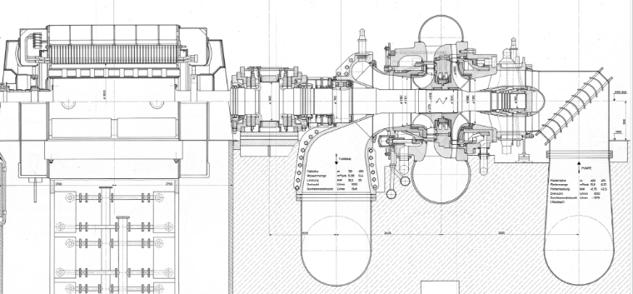
Machine description
Operator
KWO, Switzerland
Operating mode:
Pump storage used for network balance
Power in turbine mode
48MW
Power in pump mode
60MVA
Nominal speed:
1000RPM
Turbine type:
Francis, horizontal
Turbine mode:
800h/y
Typical turbine operation
Daily, variable form 0..100%, 1..3h per mode

Slide 13
Overview of the available data
rowid
KKS-Name
description_short
unit
#parameters
43 (generator, turbine)
116078
BB3.11.MFA10.FF010_.XJ01
Turbine Durchfluss
m³/s
Sampling
1/min, avg
114859
BB3.11.BAA10.CE110A.XJ01
Generatorstrom
A
History
18 months
114865
BB3.11.BAA20.CE210A.XJ01
Generatorspannung L1-L2
kV
117231
BB3.11.BAA20.CE210A.XJ02
Generatorspannung L2-L3
kV
117232
BB3.11.BAA20.CE210A.XJ03
Generatorspannung L3-L1
kV
116064
BB3.11.MFA10.CE310_.XJ01
Wirkleistung
MW
116568
BB3.11.MLA10.CE320_.XJ01
Blindleistung
Mvar
116569
BB3.11.MLA10.CE330_.XJ01
Winkel cos phi
cphi
116570
BB3.11.MLA10.CE510_.XJ01
Frequenz
Hz
116118
BB3.11.MFA13.CS021_.XJ01
DrehzahlMsg LT Drehzahl 1
U/min
116255
BB3.11.MFB11.CP040_.XJ01
KugSchie Spiralendruck
bar
116322
BB3.11.MFB30.CP010_.XJ01
Druck Turbinensaugrohr
bar
116283
BB3.11.MFB20.CP010_.XJ01
Druck Pumpensaugrohr
bar
117205
BB3.11.MLD20.CT010_.XJ01
NS-Lager Temperatur 1
°C
116758
BB3.11.MLD20.CT011_.XJ01
NS-Lager Temperatur 2
°C

Slide 14




Data Engineering - process
Value Proposal
Data Observable Matrix
Modeling & KPIs
Digital Architecture
Identification of the key indicators critical for the effective monitoring of the turbine.
Review of the available data, mapping for each indicator and specification of the algorithms.
Configuration of the algorithms for each indicator, modeling using historical data and validation.
Implementation roadmap meeting cybersecurity requirements.

Slide 15
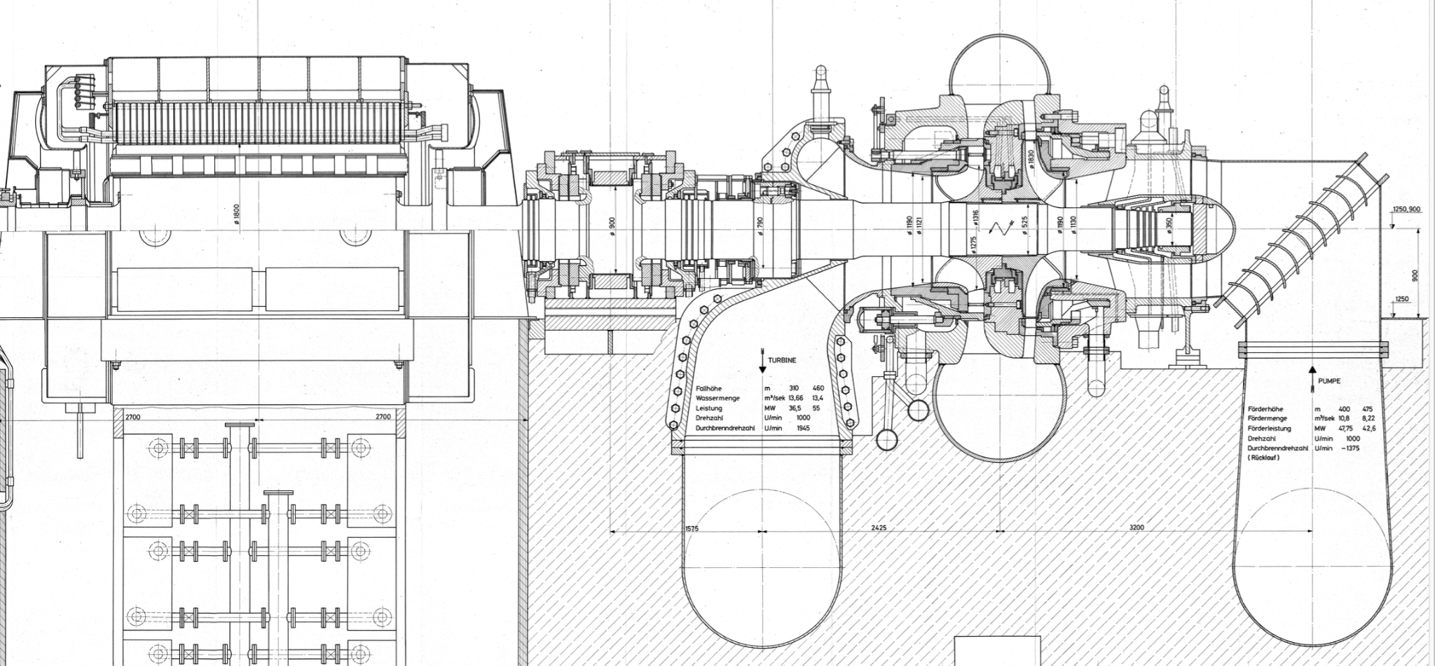
Data Observable Matrix
Value Proposal
Modeling & KPIs
Digital Architecture
KPI 4 - Combined bearing temperature
KPI 3 - Axial thrust
position
KPI 1 - Performance in turbine mode
KPI 2 - Performance in pump mode

Slide 16
Data Observable Matrix
Value Proposal
Modeling & KPIs
Digital Architecture
Indicators
KPI 1 - Performance in turbine mode
Class of algorithms
Neural network (non linear behaviour, high accuracy required)
Filtering
Constant speed, feeding for 80m bassin
Training windows
6-12 months
Data sampling
1 dataset/min
Predicted parameters
Servo motor position
Input parameters
Feeding bassin
Suction pressure
Flow
...

Slide 17
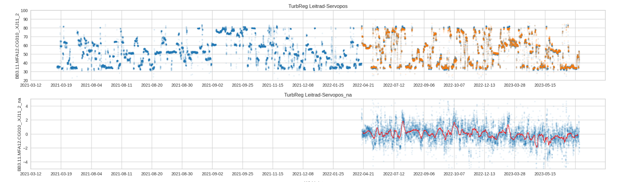
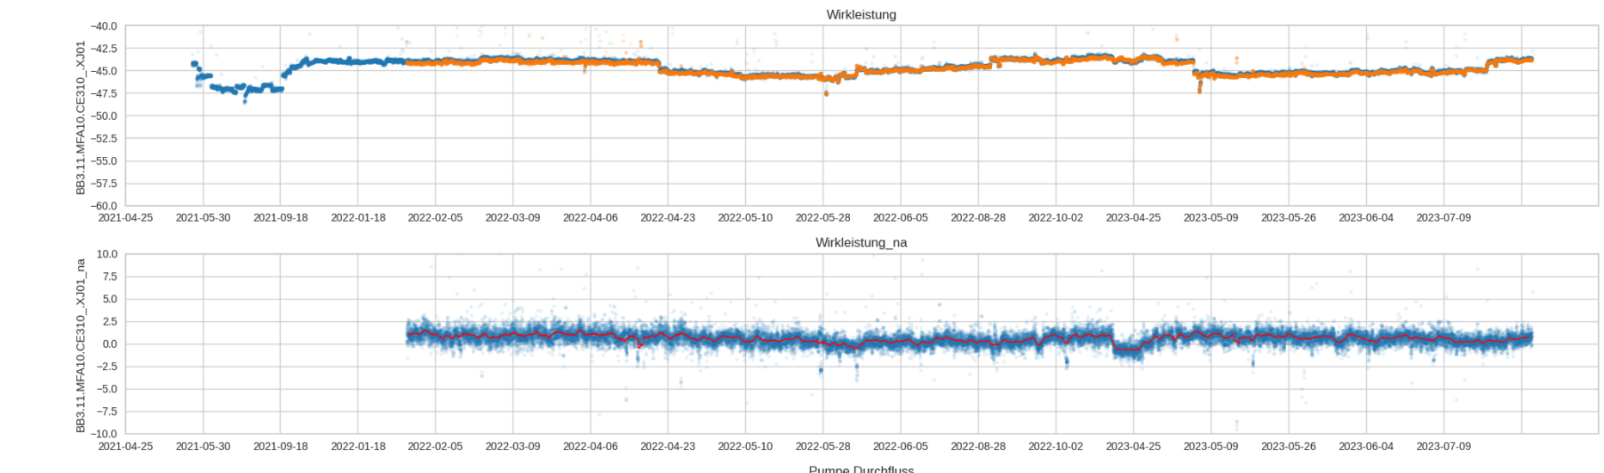
Data Observable Matrix
Value Proposal
Modeling & KPIs
Digital Architecture
Real vs Predicted values:
KP1 - Performance in turbine mode:
Expected servo-motor position
Real servo-motor position
Normalised anomaly:
Real vs Predicted values:
KPI2 - Performance in pump mode:
Expected power
Real power
Normalised anomaly:

Slide 18
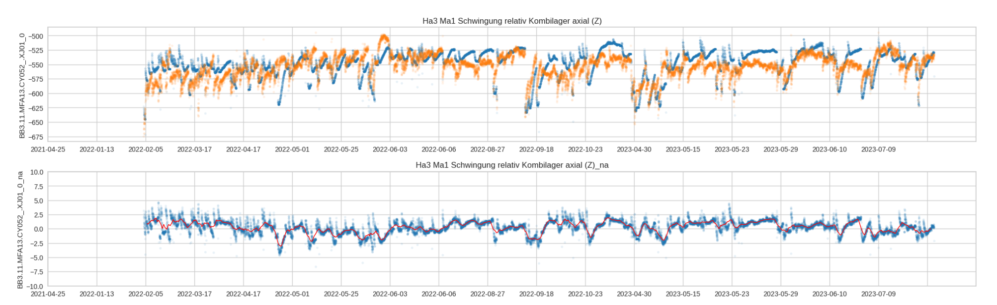
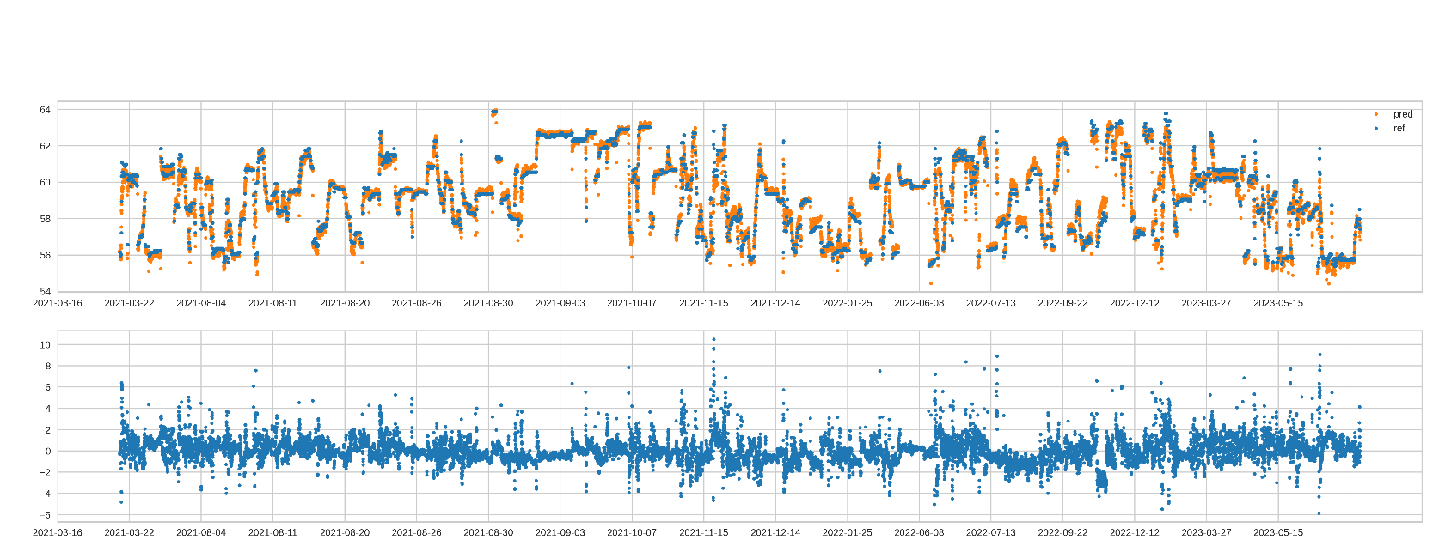
Data Observable Matrix
Value Proposal
Modeling & KPIs
Digital Architecture
Real vs Predicted values:
KPI3 - Thrust bearing position:
Expected position
Real position
Normalised anomaly:
Real vs Predicted values:
KPI4 - Combined bearing temp.:
Expected temperature
Real temperature
Model accuracy is largely below 1°C even with linear regression.
Normalised anomaly:

Slide 19
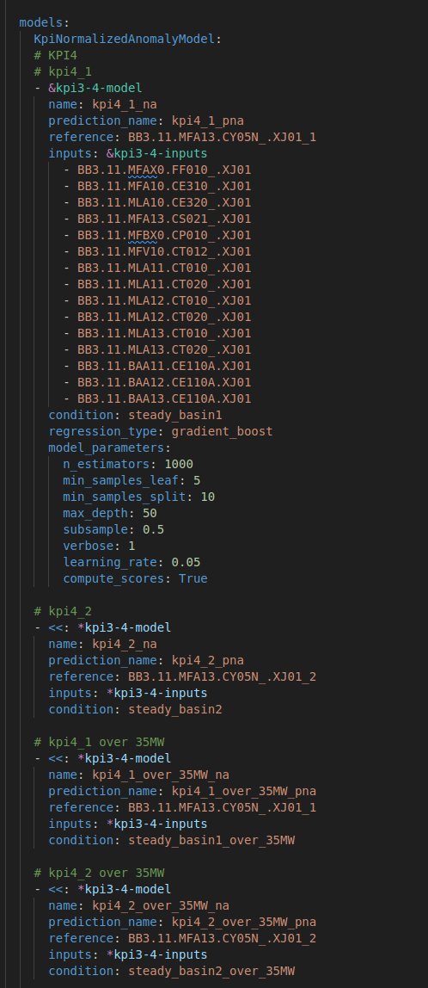
Data Observable Matrix
Value Proposal
Modeling & KPIs
Digital Architecture
AI-Analytics functions
Where
Who
Data Engineering
KWO
KWO with GradeSens support
Model configuration & Training
KWO
Cloud with offline data and GradeSens codeless analytics platform
KWO
KWO, on premises
Monitoring

Slide 20
Topics:
Introduction
Modelling methods
Use case & data Engineering
Conclusions
YJ

Slide 21
Conclusions
The digital twin approach is also applicable on complex machines such as pump storage used for the electrical load balance
The models allow to detect deviations of the servo-motor position in generator mode and electrical performance in pump modes.
Two additional models have been developed for the monitoring of the combined bearing temperature and axial thrust position
The models accuracy is good and can be used for monitoring purpose.
Next steps:
Integration of the analytics platform into KWO’s operation. An 24 months roadmap with gradual integration is under preparation.
New analytics adding deeper analysis of the ramp-up phases

Slide 22
In summary
WHY
Strategy
Knowledge-based asset management
Improving grid balancing
Fostering innovation & excellence
O&M
Faster ramp-up and ramp-down
Maintenance schedule optimisation
O&M cost reduction
HR
Empowering a data-driven culture
Enhancing decision-making, efficiency, and problem-solving
OK
To be confirmed
OK
HOW
Value of data
Proactive failure detection
Identifying power inefficiencies
Gaining knowledge on the machine behaviour
Digital architecture
Scalable and robust architecture
Transparent modelling (not a black box)
Cybersecurity
Compliance with Swiss regulation for critical assets
OK
OK
OK
WHAT
Data
Leveraging of existing SCADA data
AI-Analytics
Dedicated Models covering the generator and turbine
Algorithms optimized for limited data
Knowledge
Transparent metrics updated on a daily basis
Monitoring and preventive actions
OK
OK
OK

Slide 23


Contact us!
Predict to Perform
Yvan Jacquat
Our partner in Italy
Bd de Pérolles 7,
1700 Fribourg - Suisse
Fondateur et CEO
Via Porta Rossa 11 – Madonna dell’ Olmo | 12100 Cuneo - ITALY
Ph +39 0171 692068 |
P.I. 00444390041 |
SDI: W7YVJK9
yvan@gradesens.com,
+41 76 589 61 91

